Slide 1
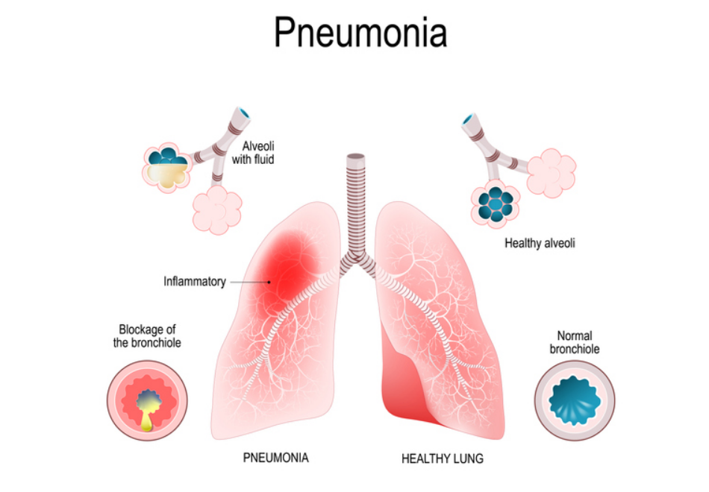
X-Ray Pneumonia Prediction
Chest X-ray Images
Project By Nihal Gajbhiye
LET’S MAKE A BETTER WORLD

Slide 2
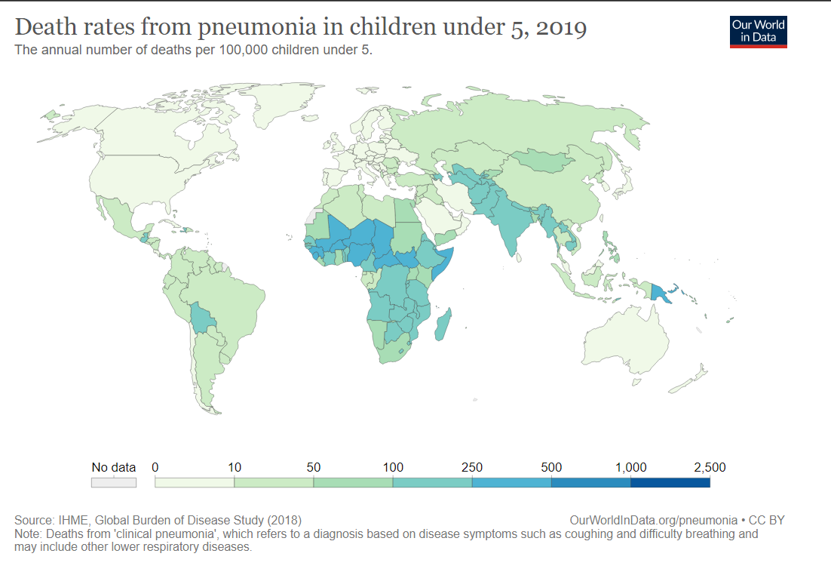
LET’S MAKE A BETTER WORLD

Slide 3
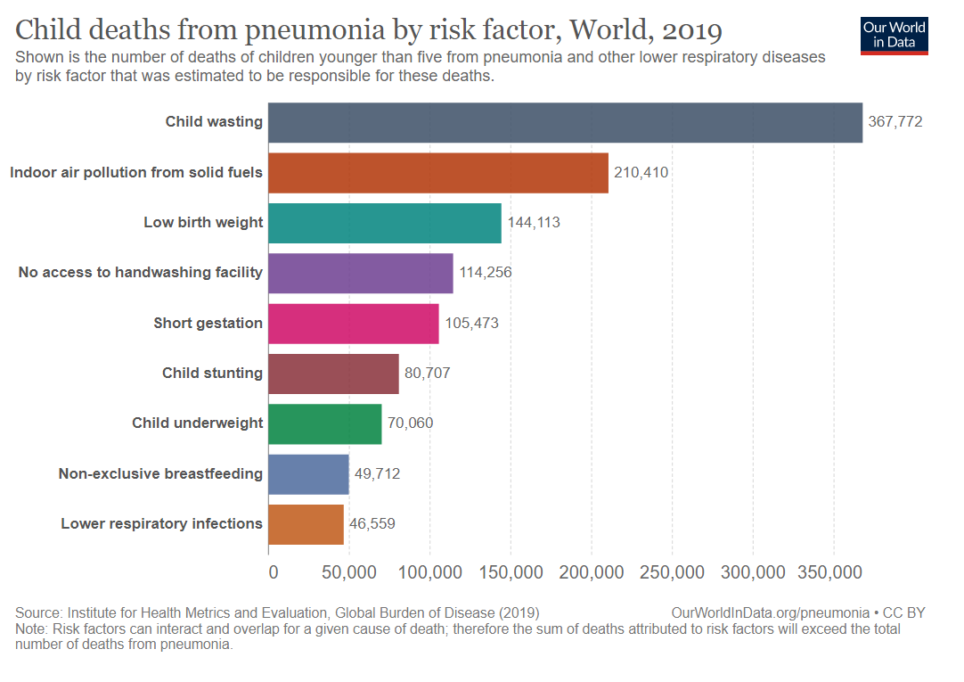
LET’S MAKE A BETTER WORLD

Slide 4
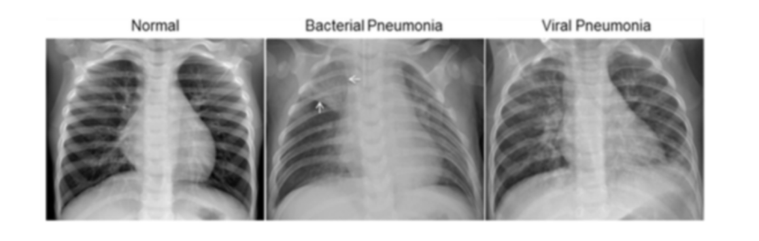
The normal chest X-ray (left panel) depicts clear lungs without any areas of abnormal opacification in the image
Bacterial pneumonia (middle) typically exhibits a focal lobar consolidation, in this case in the right upper lobe (white arrows)
Viral pneumonia (right) manifests with a more diffuse ‘‘interstitial’’ pattern in both lungs.
LET’S MAKE A BETTER WORLD

Slide 5
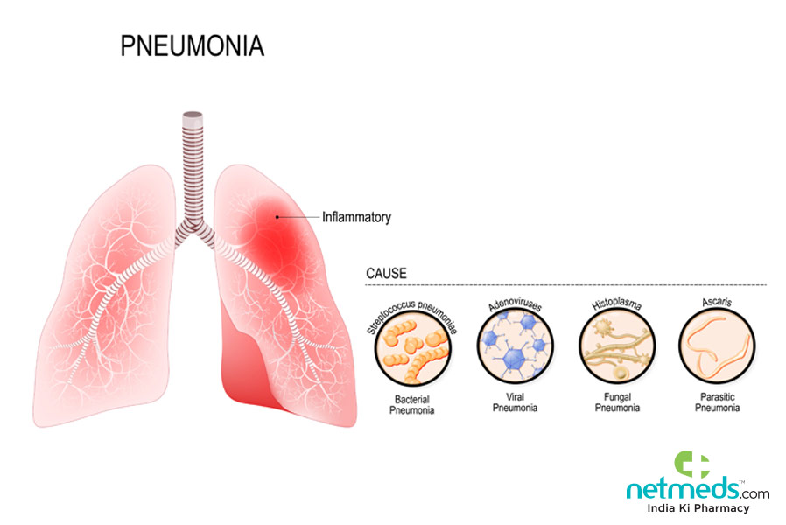
TYPES
LET’S MAKE A BETTER WORLD

Slide 6
CONVOLUTIONAL NEURAL NETWORK IMAGE PROCESSING TECHNIQUE OF MAX POOLING VISUALIZATION
LET’S MAKE A BETTER WORLD

Slide 7
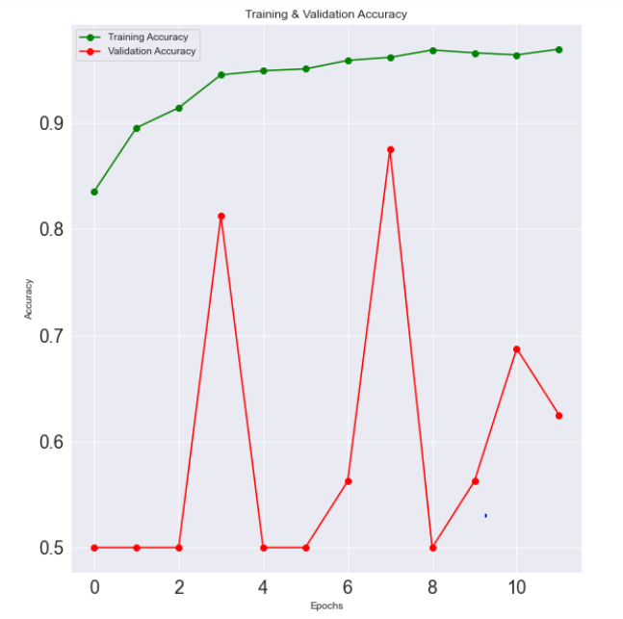
Training & Validation Accuracy
Model gives 96.95% train accuracy, and test set accuracy of 92.46%.
LET’S MAKE A BETTER WORLD

Slide 8
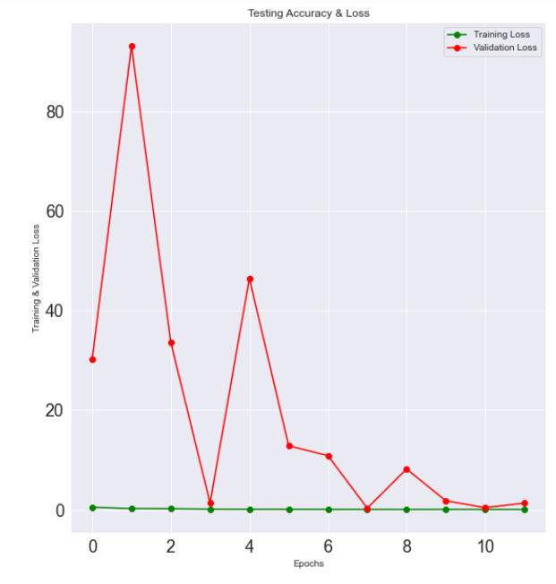
Training & Validation Loss
Loss of test model comes out to be 0.32.
LET’S MAKE A BETTER WORLD

Slide 9
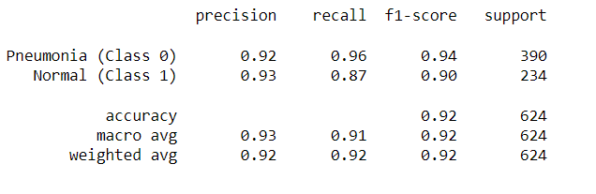
Classification Report
Harmonic Mean of Precision and recall i.e f1 score is 0.92.
LET’S MAKE A BETTER WORLD

Slide 10
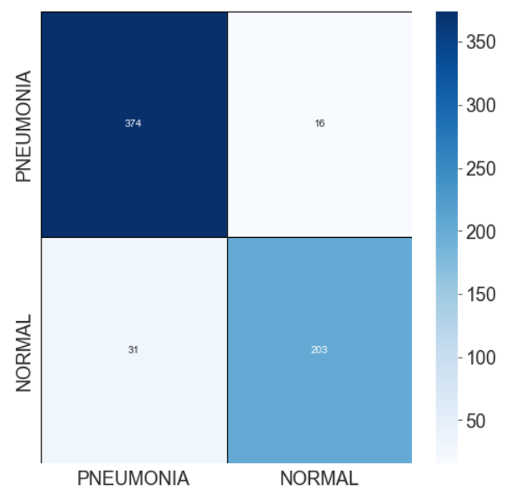
Confusion Matrix
True Positive : 374
True Negative : 203
LET’S MAKE A BETTER WORLD

